Slide 1
Configurable CAM and SRAM
Jiaxing Wang, Bryce Hwang
EC571 Final Project
April 22, 2026
Based on “A 28 nm Configurable Memory (TCAM/BCAM/SRAM) Using Push-Rule 6T Bit Cell Enabling Logic-in-Memory”

Slide 2
Agenda
Motivation: Why Configurable?
Configurable Memory Architecture
Features
Examples & Simulation Results
Cadence Schematics

Slide 3
01
Motivation
Notes:
BRYCE – WHOLE SECTION

Slide 4
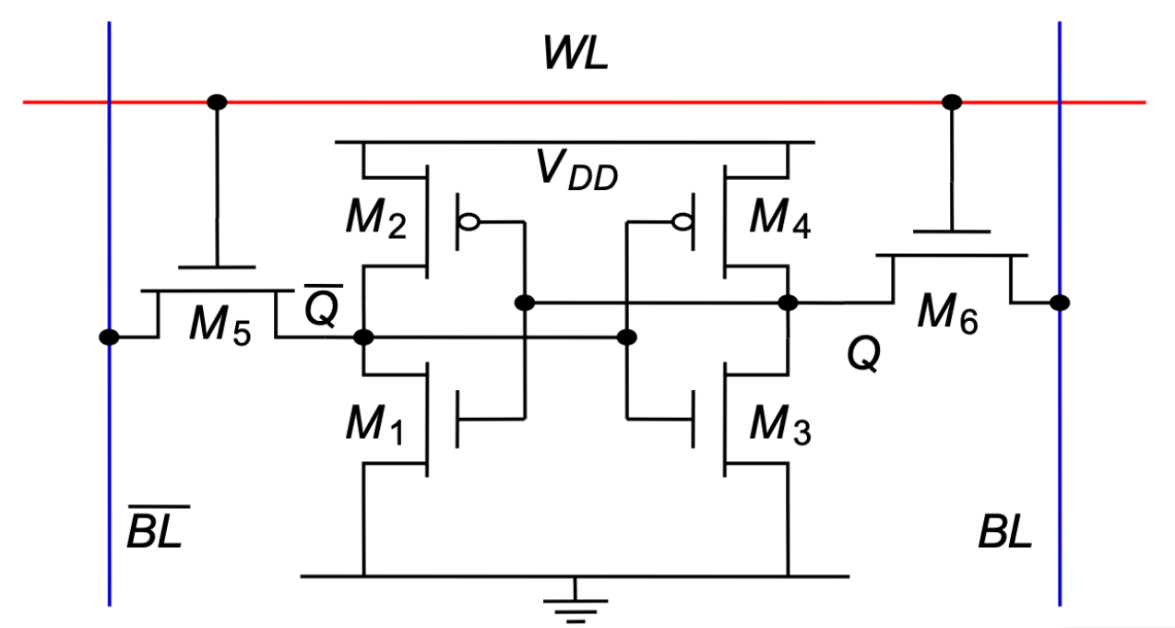
Review: 6T SRAM
Standard 6T SRAM
Notes:
Basic sram cell
It has six transistors: M1 and M3 are the pull-down NMOS, M2 and M4 are the pull-up PMOS, and these four form two cross-coupled inverters that hold the stored bit. M5 and M6 are the two access transistors controlled by the word-line.

Slide 5
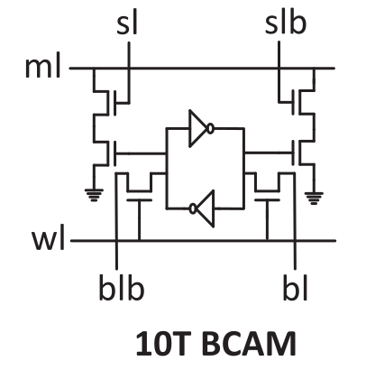
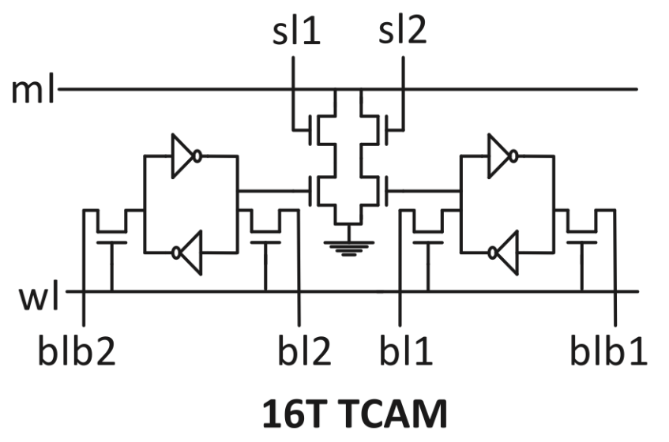
Review: CAM
ml – match line
Can allow 1, 0, X
Notes:
Traditional BCAM uses 10 transistors; it has a match line that tells you if data equal to search line
Traditional TCAM uses 16; it is same as BCAM but allows for Don’t Cares when searching
On the left is the 10T BCAM cell. It's essentially a 6T SRAM storage element plus 4 extra transistors that implement an XNOR comparison between the stored bit and the search line. The match line runs horizontally — if every bit in the row matches, the match line stays high. One mismatch anywhere pulls it low.
On the right is the 16T TCAM cell. It needs double the storage to represent the three states — 0, 1, and X — which is why it has 16 transistors. Two search lines, sl1 and sl2, handle the extra state.

Slide 6
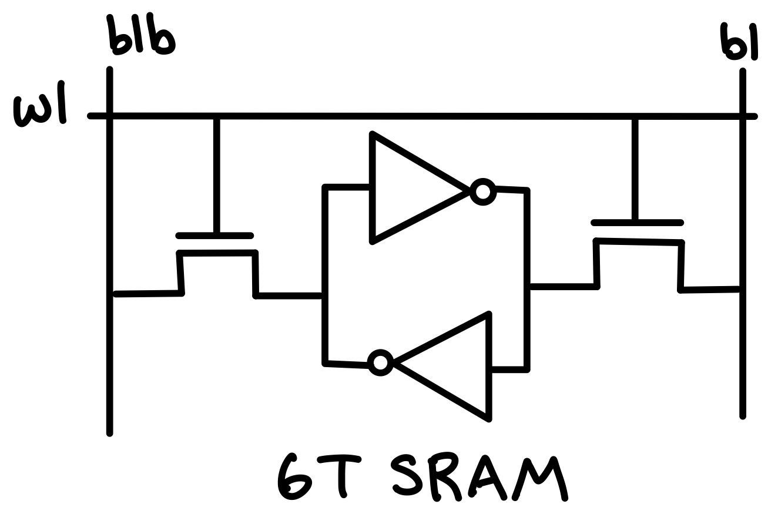
Problems with CAM
Bigger (10T vs 6T)
Higher capacitance
More power
Less energy efficient
vs.
Solution: Use 6T SRAM cells as CAM
Notes:
Problem: CAM sizes too big! Foundries overlook CAM innovation for SRAM optimizations
Larger arrays mean higher capacitance, higher power consumption, and worse energy efficiency per search operation
Solution: combine SRAM and CAM so they are interchangeable! CAM becomes way denser but it sacrifices some SRAM performance
Improve CAM density with little impact to SRAM performance
Find more motivation for why we need to combine

Slide 7
02
Configurable Memory Architecture

Slide 8
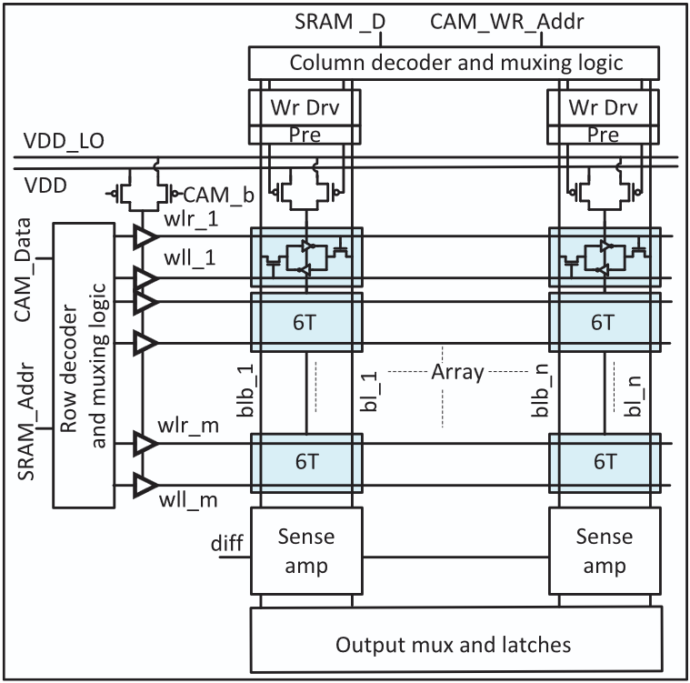
Proposed Architecture
Notes:
JIAXING
This is the proposed configurable memory architecture. In the middle it uses 6T SRAM cells as storage.
On the left is a row decoder. Here you pass in either the SRAM address or CAM data, and then you use combinational logic to control the word lines.
On the top is the same, but for SRAM data or CAM write address, and the top column decoder will control the bit lines.
On the bottom are sense amplifiers and more combinational logic to show outputs for either SRAM or CAM operations.

Slide 9
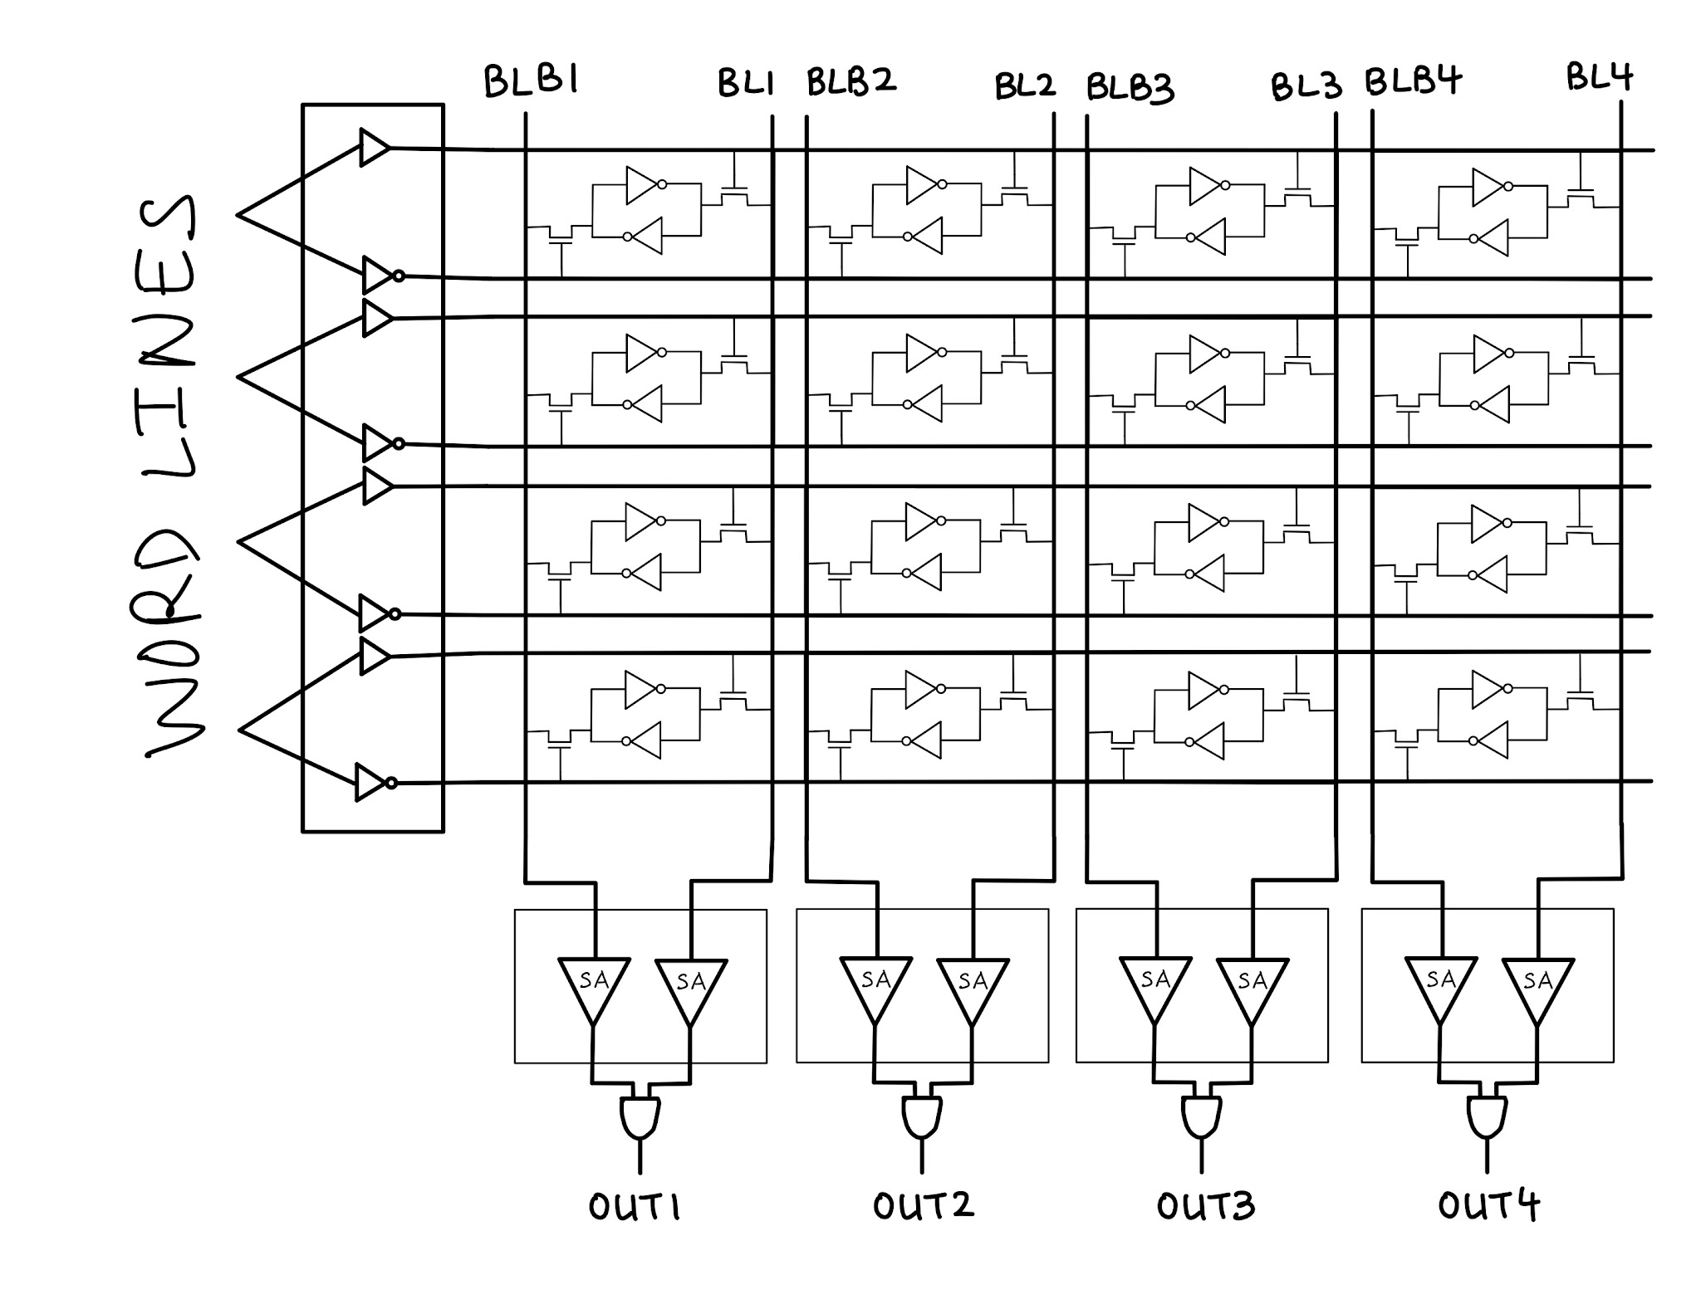
Memory Architecture Features
SRAM
Read, Write (row-wise)
BCAM
Search, Write (column-wise)
TCAM
Search, Write
Logic Operations
AND, NOR, etc.
Notes:
BRYCE
In SRAM mode, words accessed row by row, standard differential read and write.
BCAM mode, words are stored column-wise instead of row-wise — you can see that in the diagram. Result comes out at the bottom through the sense amplifiers. Write takes two cycles because of the column-wise organization.
TCAM extends BCAM by adding a don't care state. Two columns are used per word to encode three states: 00 for 0, 11 for 1, and 01 for don't care.
Finally, logic-in-memory reuses the BCAM search circuitry to perform AND and NOR between stored rows directly inside the array, which saves energy and frees the ALU.

Slide 10
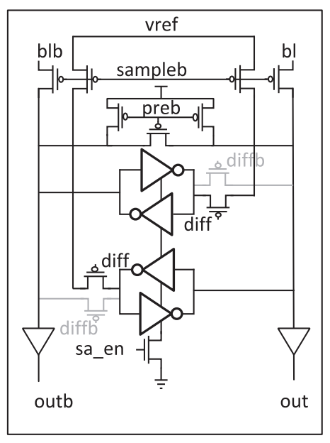
Configurable Sense Amplifier
Switches function depending on mode
CAM mode: cross-coupled inverters operate independently
Becomes two sense amplifiers
SRAM mode: cross-coupled inverters are in parallel
Becomes one sense amplifier
Notes:
BRYCE
Configurable sense amplifier — is a latch type sense amp (different from current mirror sense amp seen in class)
switches function in when in CAM or in SRAM mode
CAM mode: diff = 0; the two cross-coupled pairs operate independently as two single-ended amplifiers
Upper cross-couple compares bit-line-bar (blb) against reference voltage (vref)
Lower cross-couple compares bit-line (bl) against reference voltage
SRAM mode: diffb = 0; switches are closed, tying the two cross-couple pairs in parallel
Differential sense amplifier
Senses voltage difference between bl and blb

Slide 11
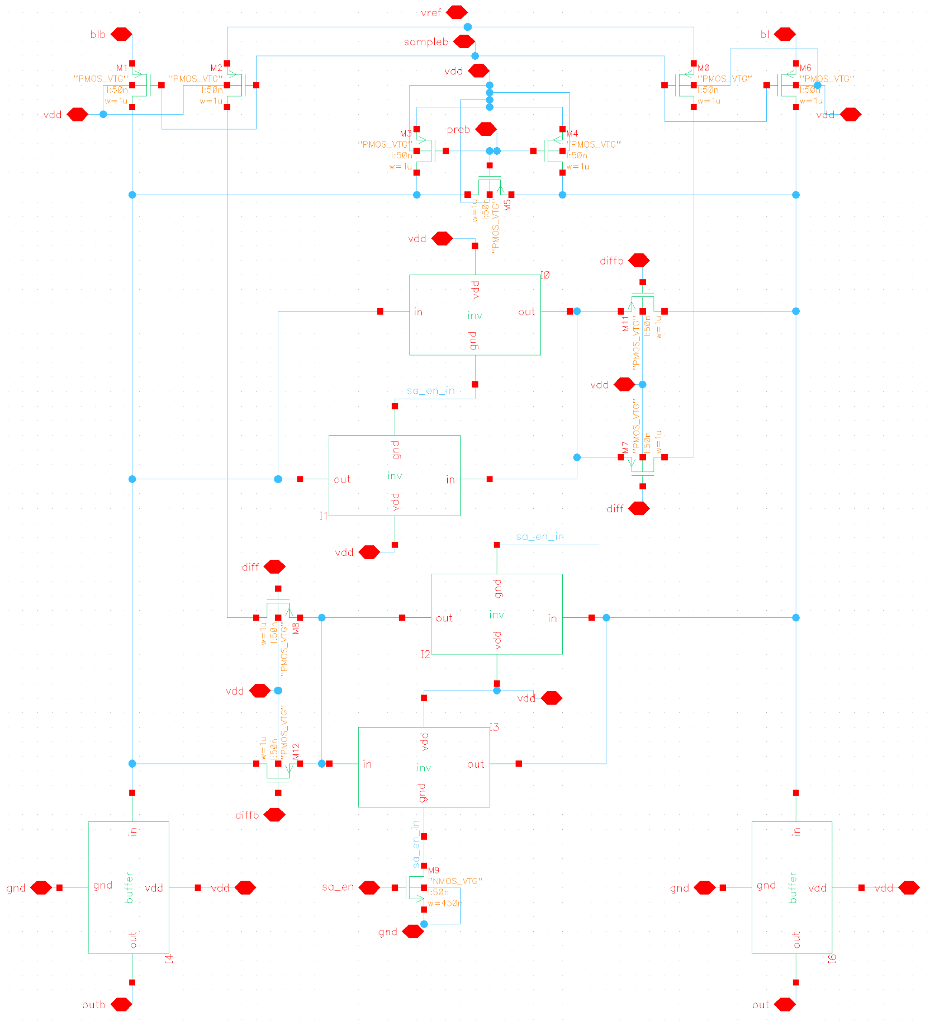
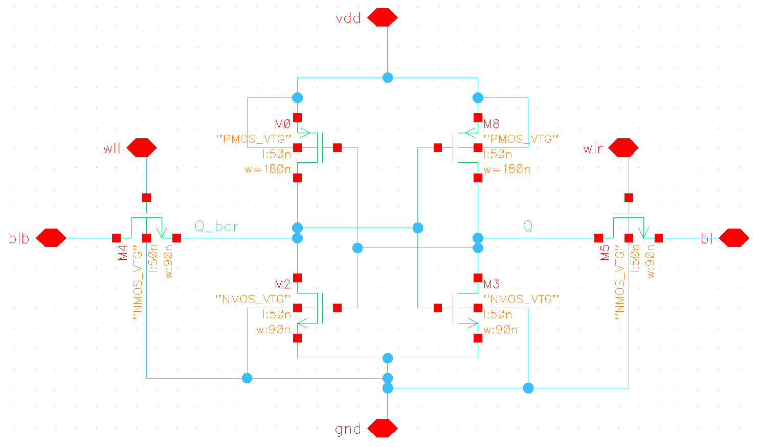
Transistor Sizings
6T SRAM Cells
Standard 90nm NMOS, 180nm PMOS
Access NMOS a bit stronger (120nm)
Sense Amplifier
Bit Line PMOS: increase based on bit line load
Notes:
JIAXING
I’m gonna talk about transistor sizings for a little bit. Each of the 6T SRAM cells are pretty standard: 90nm for NMOS and 180nm for PMOS
The sense amplifier transistor sizings are more complicated. I won’t go through all of them here, but only the important ones. For example, the bit line PMOS
The bit line PMOSes here connect the sense amplifier to the BL and BLB of memory cells, so their sizing is proportional to how many bits are on a column.

Slide 12
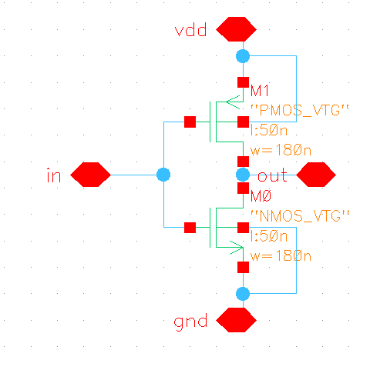
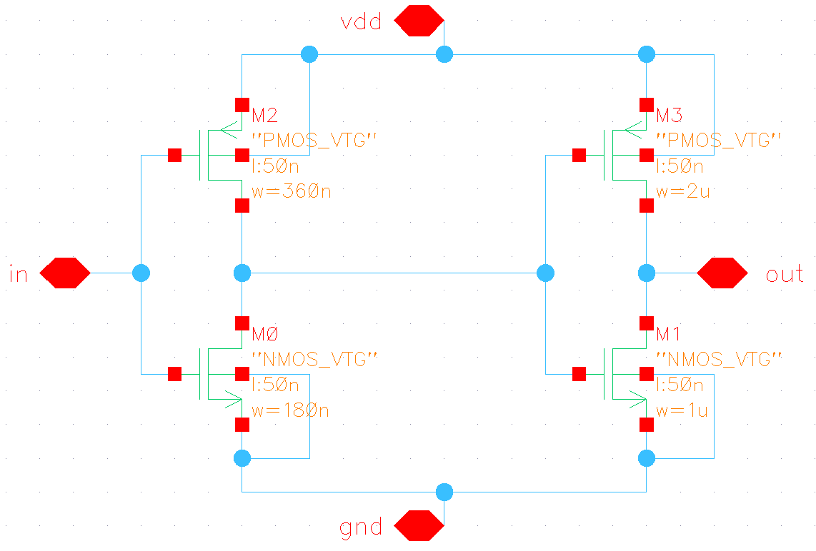
Transistor Sizings
Sense Amp Inverters
Want to bias towards pulling down
180nm NMOS, 180nm PMOS
Buffer
First inverter 180nm NMOS, 360nm PMOS
Second inverter size based on output load
Notes:
JIAXING
Sense amplifier is precharged to HIGH, and during evaluation stage it will pull down, so we want the coupled inverters to be pull-down biased
The buffers in the sense amplifier are here, and they help with outputting an ideal LOW signal as well as making sure the sense amp can drive the output load. So we pre-set the first inverter in the buffer to be 180 and 360, and the second inverter will be sized based on output load. It is set to 1u and 2u right now, but can be smaller.

Slide 13
03
Examples: BCAM Search, Logic Operations

Slide 14
SRAM Read
SRAM Write
BCAM Search
BCAM Write
TCAM Search
TCAM Write
Logic Operations
Notes:
JIAXING
So this is our memory structure, we have a 4x4 array of 6-transistor SRAM cells, with word lines going horizontally and bit lines going vertically.
In this example, we will cover a binary CAM search: it will return the address (column) that has the matching content.
For the BCAM Search example, our decoder will turn on either the top or bottom word line depending on the logic value.

Slide 15
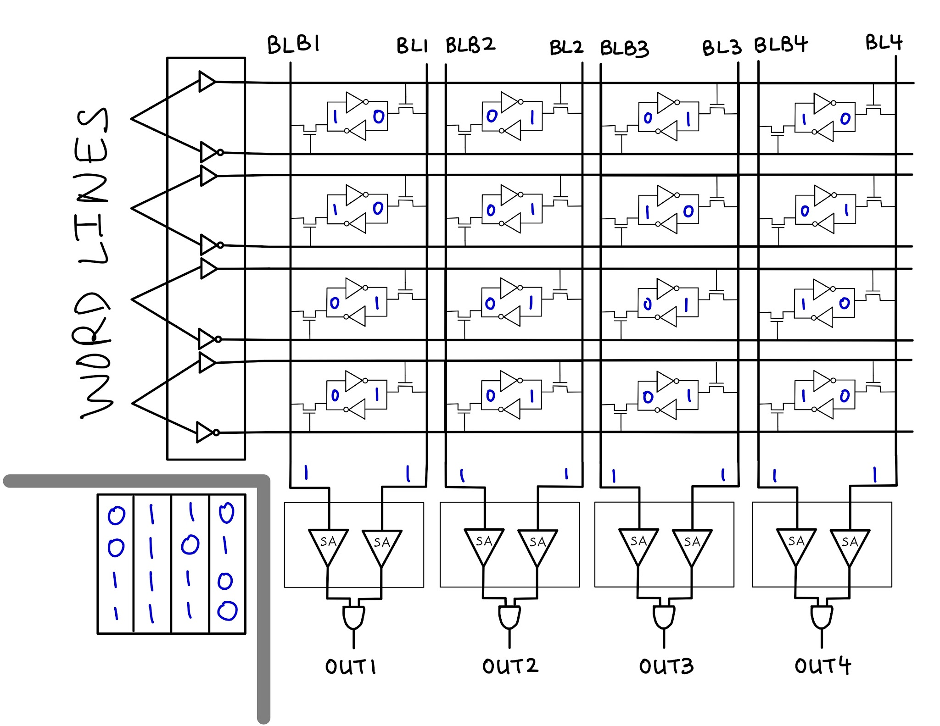
SRAM Read
SRAM Write
BCAM Search
BCAM Write
TCAM Search
TCAM Write
Logic Operations
Load data, precharge bitlines
Notes:
JIAXING
Let’s load the memory with some data. All bitlines are precharged to Vdd

Slide 16
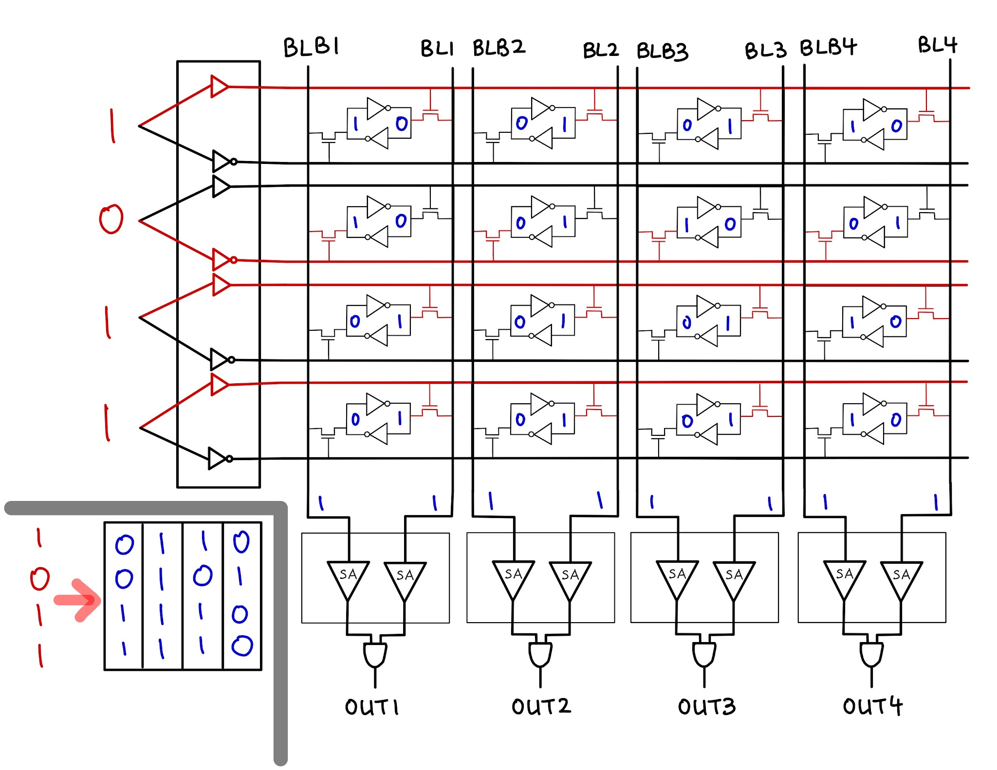
SRAM Read
SRAM Write
BCAM Search
BCAM Write
TCAM Search
TCAM Write
Logic Operations
Notes:
JIAXING
We’re gonna search for 1011, which you can see is in column 3 here. 1011 will turn on these access transistors, which I’ve shown in red

Slide 17
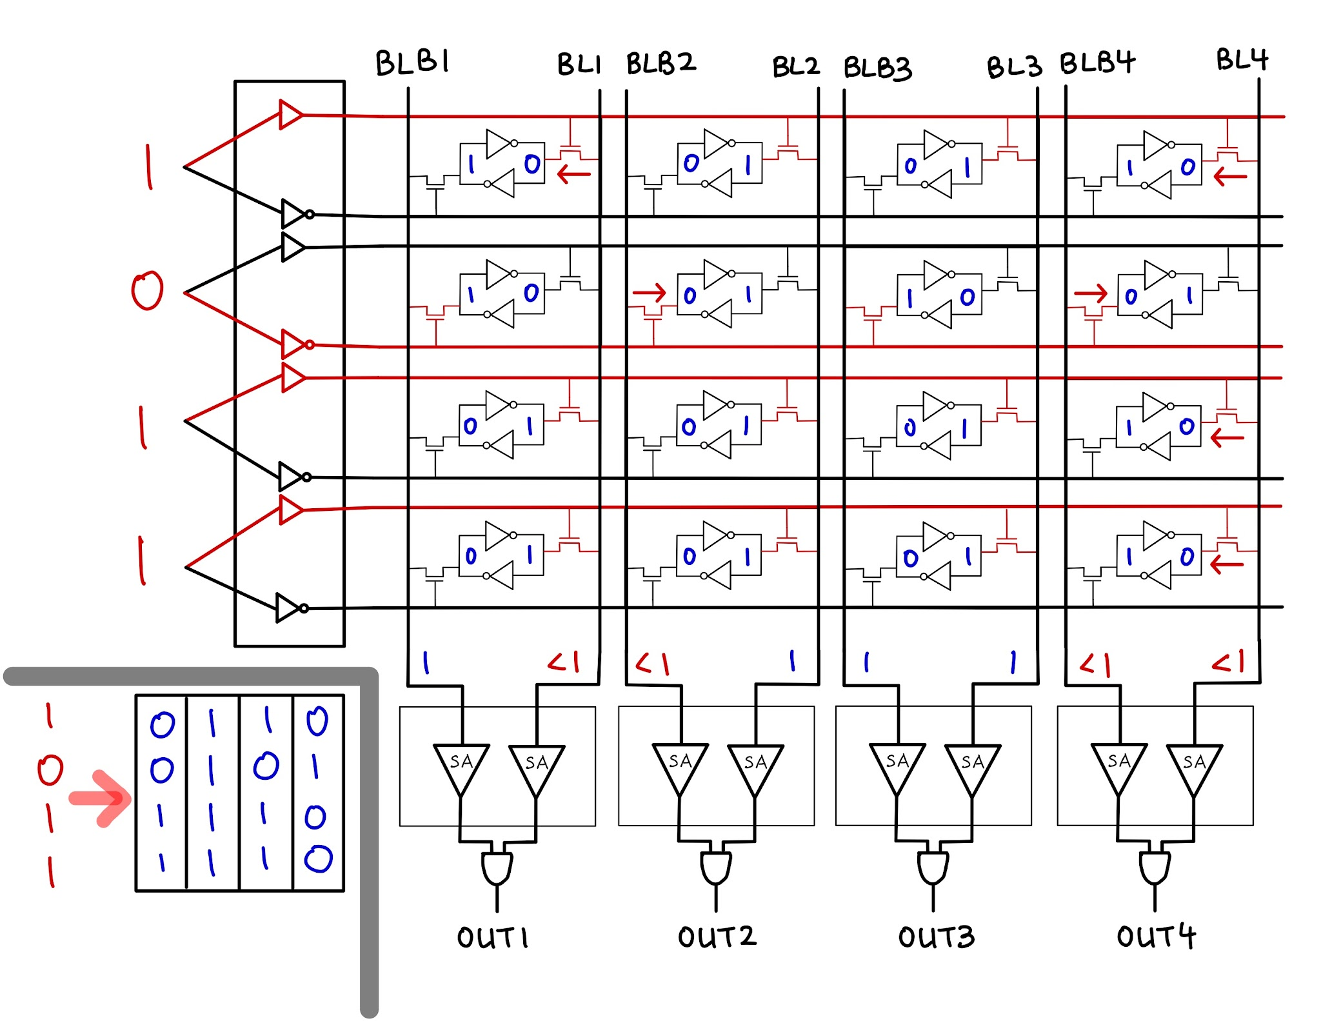
SRAM Read
SRAM Write
BCAM Search
BCAM Write
TCAM Search
TCAM Write
Logic Operations
Notes:
JIAXING
And what happens is: Since bitlines precharged to 1, any 0’s in data will make the bitline start discharging.
You can see this clearly in column 4.

Slide 18
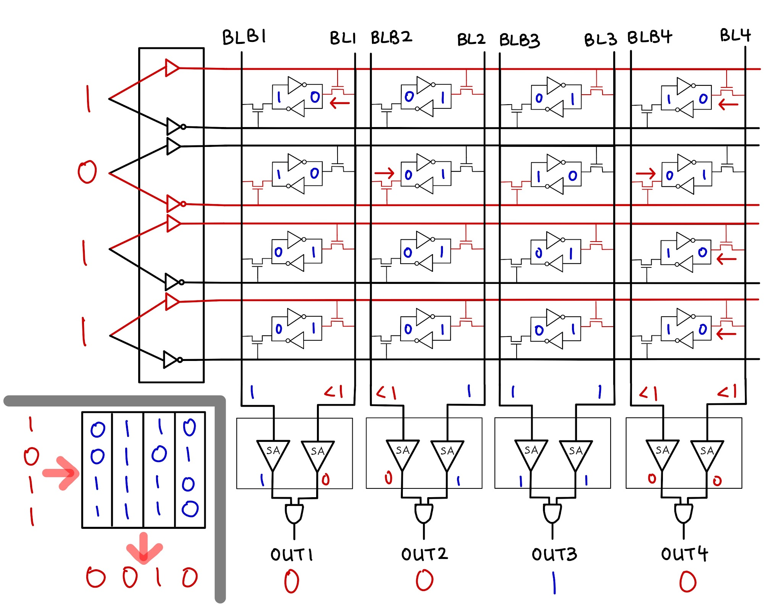
SRAM Read
SRAM Write
BCAM Search
BCAM Write
TCAM Search
TCAM Write
Logic Operations
Notes:
JIAXING
The sense amplifiers will pull down any signals that began to discharge. So at our output we get 0010, which makes sense because our search term matched with the data in column 3

Slide 19
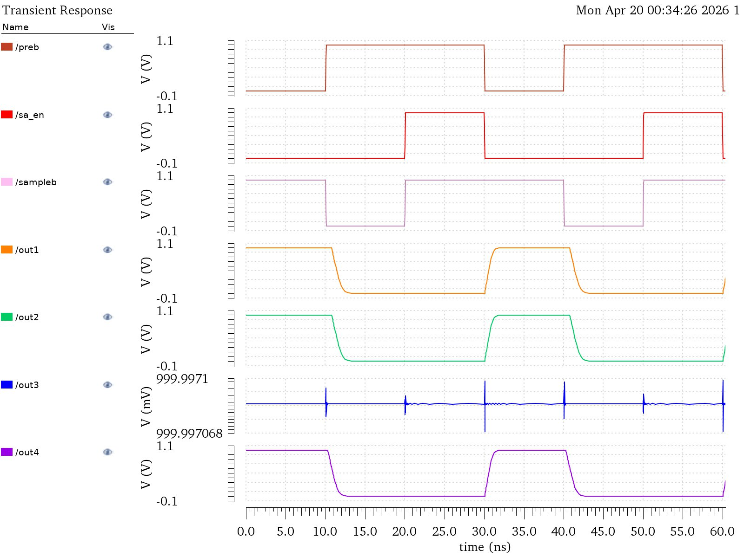
BCAM Search Simulation
Evaluation Stage: preb=1, sampleb=1, sa_en=1
0
0
SRAM Read
SRAM Write
BCAM Search
BCAM Write
TCAM Search
TCAM Write
Logic Operations
1
0
Notes:
JIAXING
We simulated this in Cadence, and as you can see, during the evaluation stage, the output of our simulation matches the 0010 we just talked about.

Slide 20
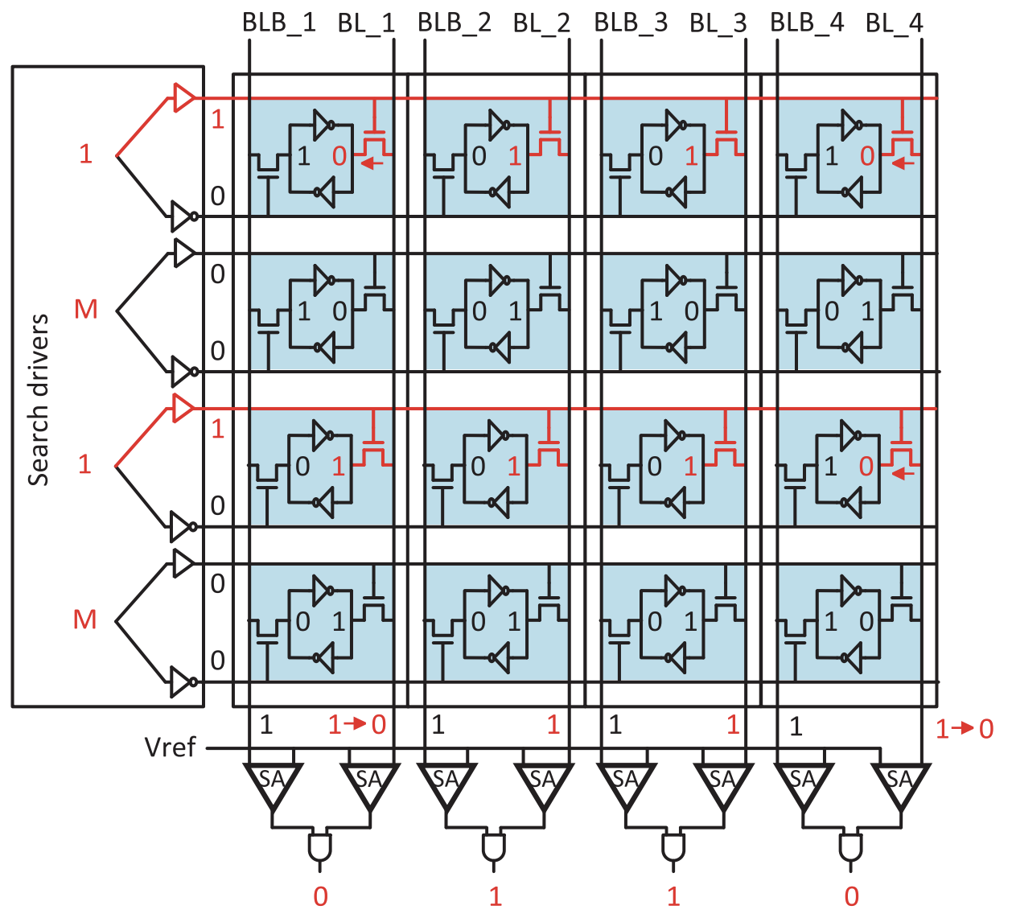
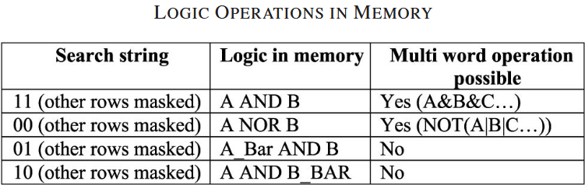
Logic Operations in Memory
SRAM Read
SRAM Write
BCAM Search
BCAM Write
TCAM Search
TCAM Write
Logic Operations
(ex. AND)
Word lines: 1 or 0 if using row, Mask (M) if not
Mask turns OFF both word lines
Output: Result of logic operation
ex. AND
WL = 1 for rows 1 and 3
Columns 2 and 3 output TRUE
Notes:
BRYCE
Normally when you want to compute something, you have to pull data out of memory, send it across a bus to the ALU, do the operation, and write it back. Every one of those transfers burns energy. Logic-in-memory skips all of that — the computation happens right inside the array, using the same circuits we already built for CAM search.
The way AND works is you just turn on the right-side access transistors for the two rows you care about at the same time. If either row has a zero in a given column, it pulls the bit-line down. So the bit-line only stays high when both rows have a one — that's exactly AND. NOR works the same way but uses the left-side transistors, which connect to the complement side of the cell. And because only two word-lines are active instead of all of them, there's much less risk of disturbing the cells, so we can run at nearly double the frequency of full BCAM mode.
The configurable memory can perform bitwise AND and NOR between two or more rows stored in the array — without reading the data out first
This is done by reusing the BCAM search circuitry: enabling the word-lines of the target rows while masking all others
AND: apply search string "1" to WLR for both target rows — any "0" in either row pulls BL low → output = A AND B
NOR: apply "0" to WLL for target rows → output = A NOR B
Why this matters: no data movement between memory and ALU → lower energy, higher throughput; the ALU is freed for more complex operations

Slide 21
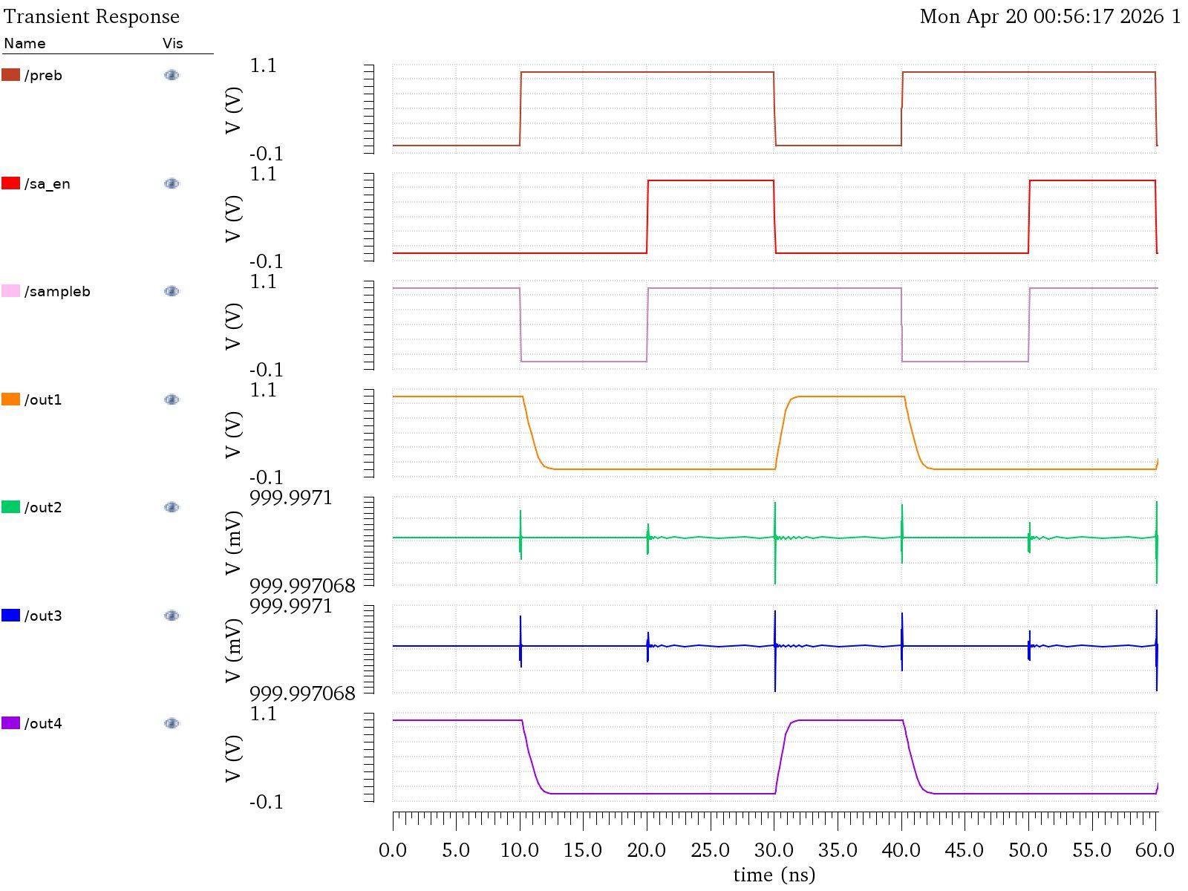
Logic Operation Simulation: AND
0
1
SRAM Read
SRAM Write
BCAM Search
BCAM Write
TCAM Search
TCAM Write
Logic Operations
1
0
Notes:
BRYCE
The way AND works is you just turn on the right-side access transistors for the two rows you care about at the same time. If either row has a zero in a given column, it pulls the bit-line down. So the bit-line only stays high when both rows have a one — that's exactly AND. NOR works the same way but uses the left-side transistors, which connect to the complement side of the cell. And because only two word-lines are active instead of all of them, there's much less risk of disturbing the cells, so we can run at nearly double the frequency of full BCAM mode.

Slide 22
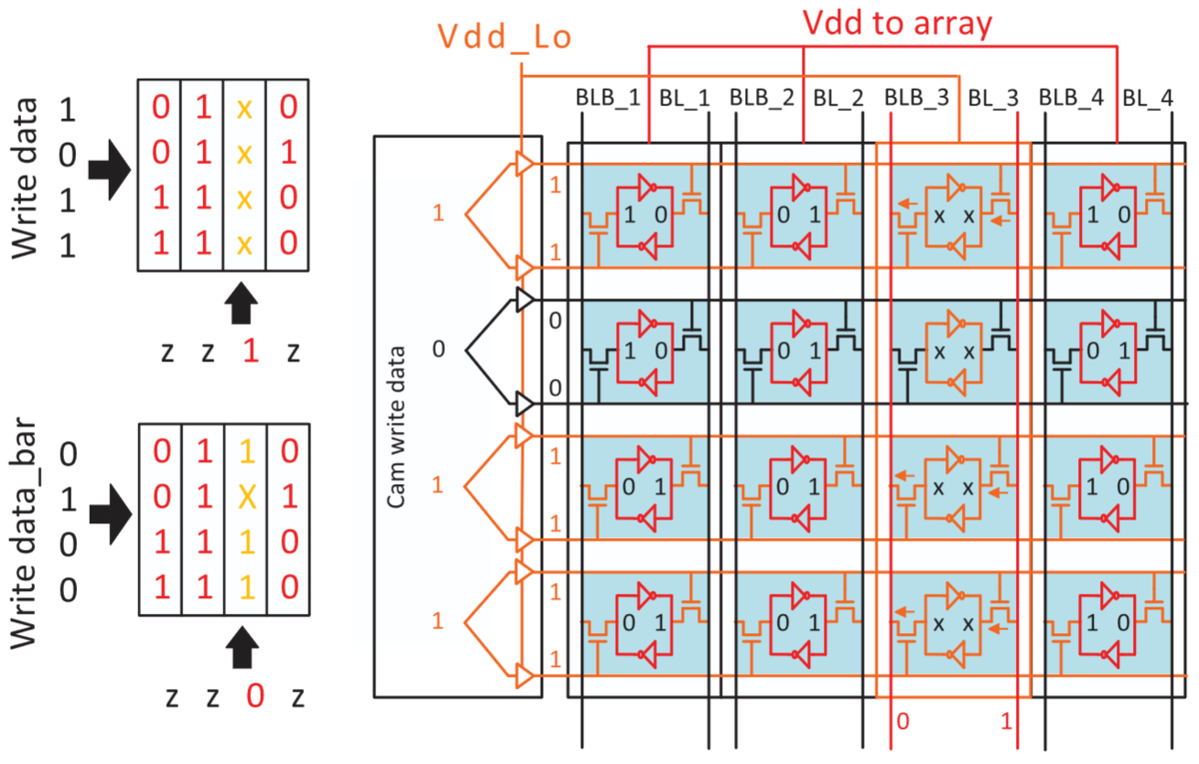
Search Robustness
word lines
Drive word lines at Vdd_Lo ≈ 0.5V
Weakens access transistors
Prevents data corruption
Use during CAM Write and Search
Fig. 9. BCAM column-wise write. Orange lines are Vdd_Lo, while red lines are nominal Vdd.
Notes:
JIAXING
If Multiple word lines are active simultaneously in CAM mode, then some cells might experience a read upset, which may corrupt our data.
One way to prevent read upsets is to change the sizing of the access transistors, but since the 6T SRAM cells are used for SRAM and CAM, it’s hard to size them to account for every feature of our memory
Solution: drive word-lines at a lower voltage, say 0.5V, instead of full Vdd (1V)
Weakens access transistors and prevents data corruption; use this lower voltage during CAM write and CAM search

Slide 23
04
Cadence Schematics
Notes:
BRYCE — ALL SLIDES

Slide 24
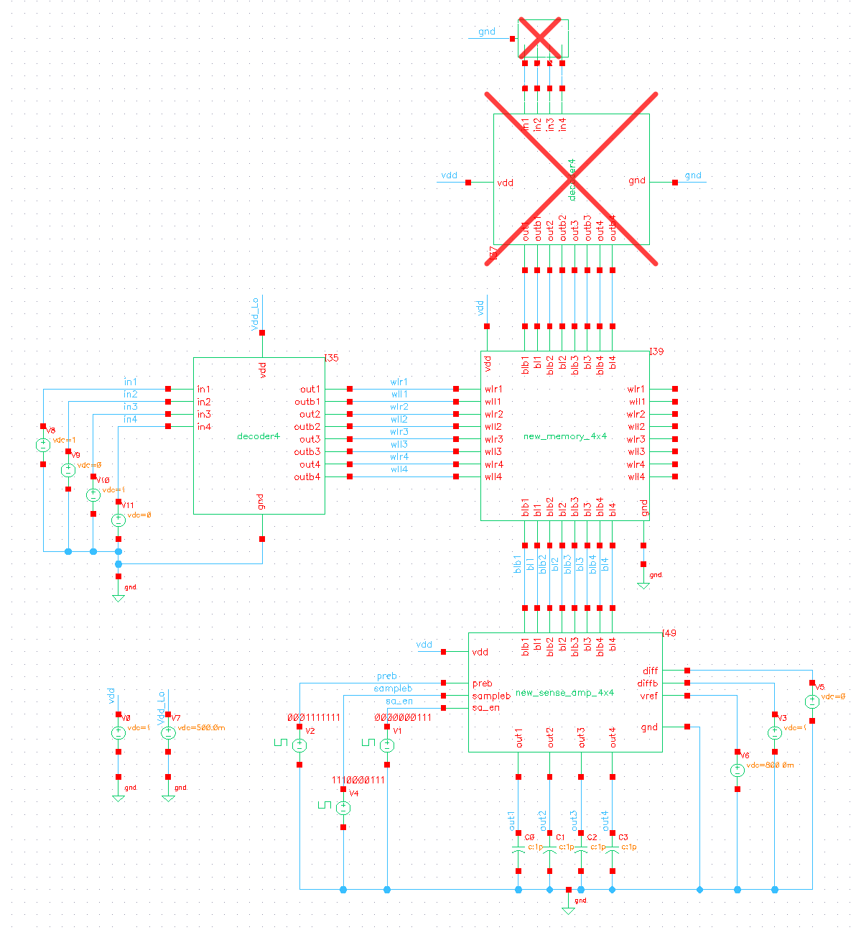
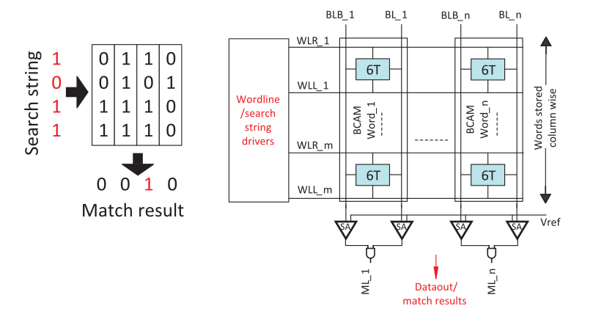
Architecture Schematic
Notes:
BRYCE
The decoder will control the word lines depending on what operation is being done.

Slide 25
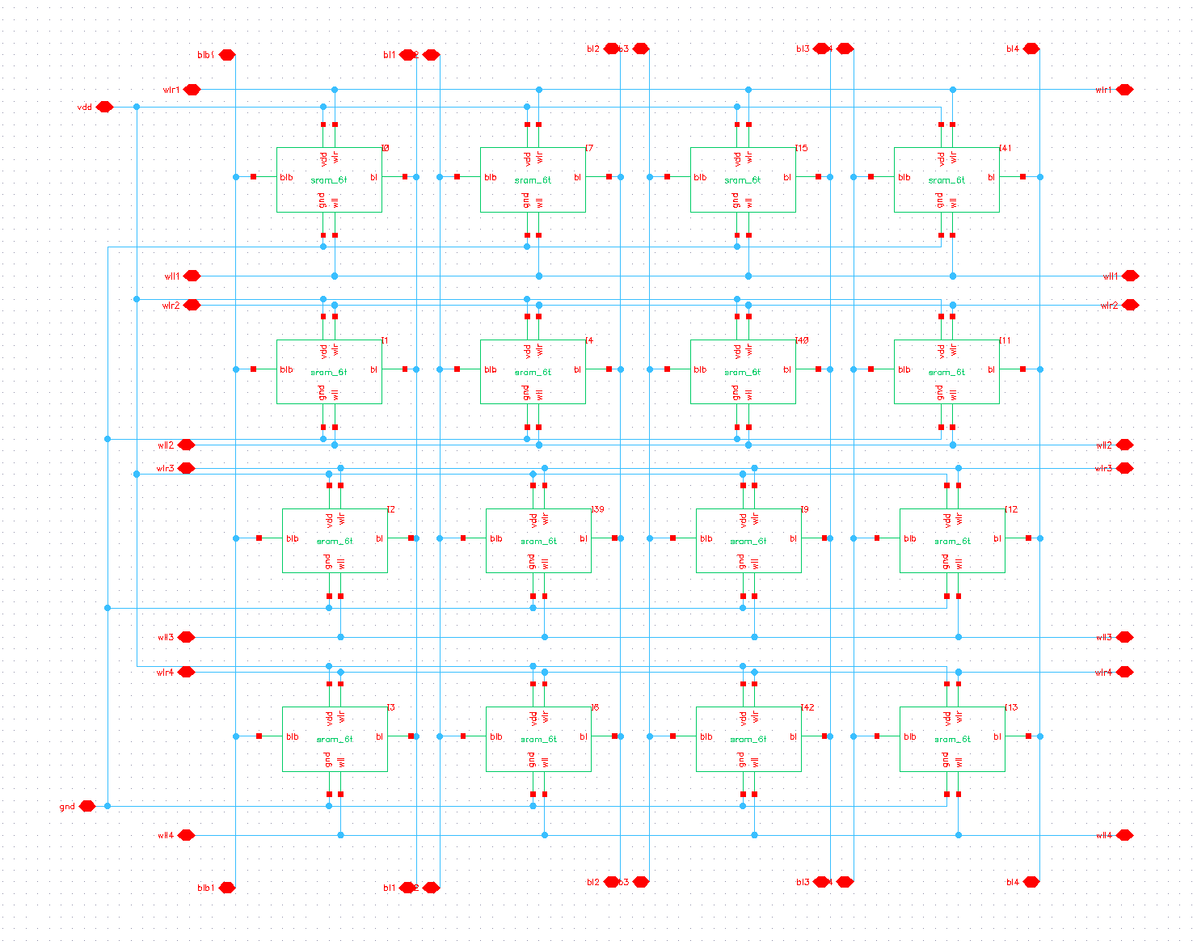
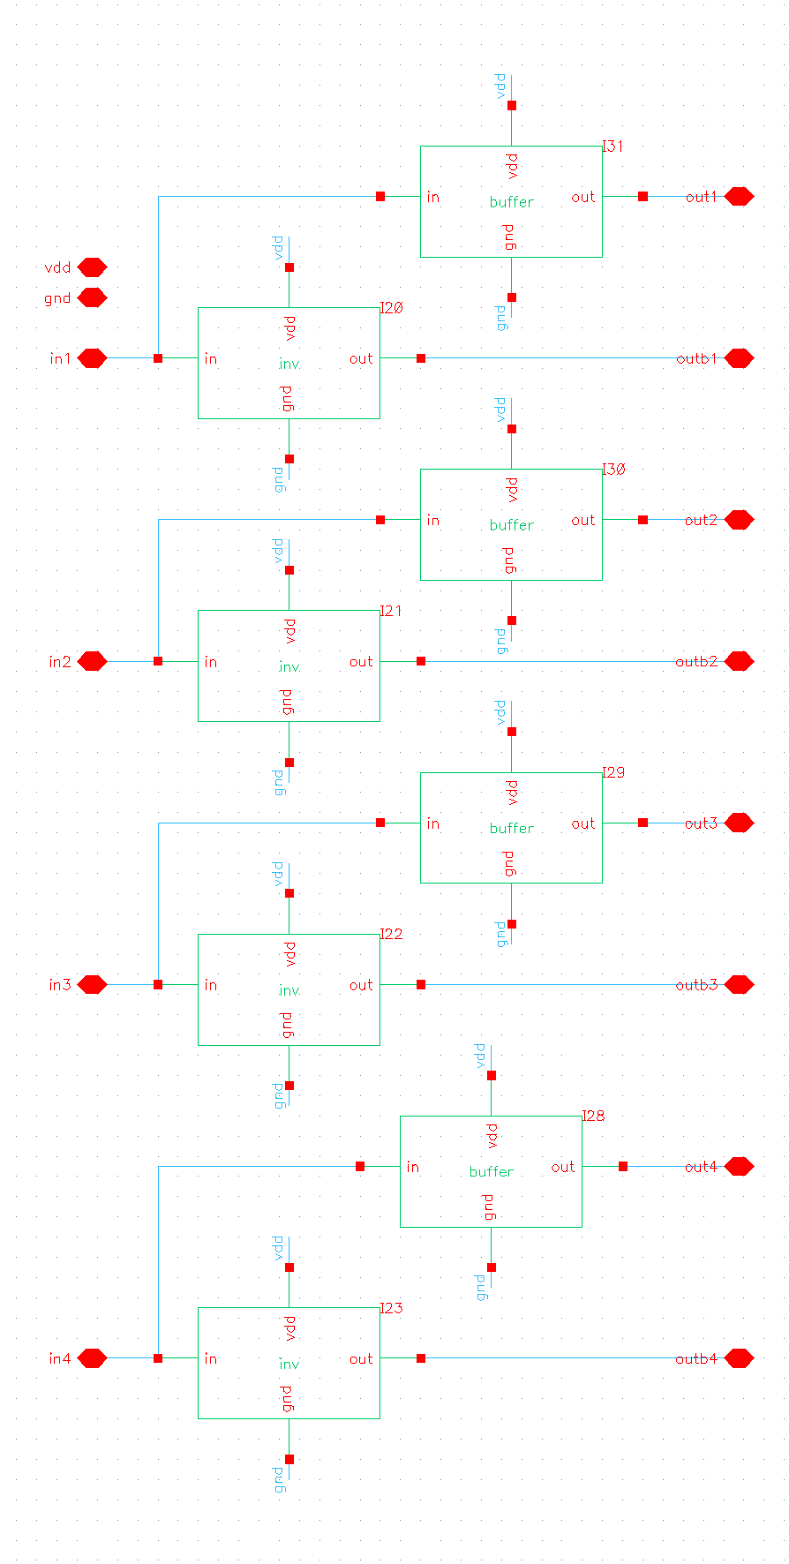
Buffer & Memory Cells
Notes:
BRYCE

Slide 26
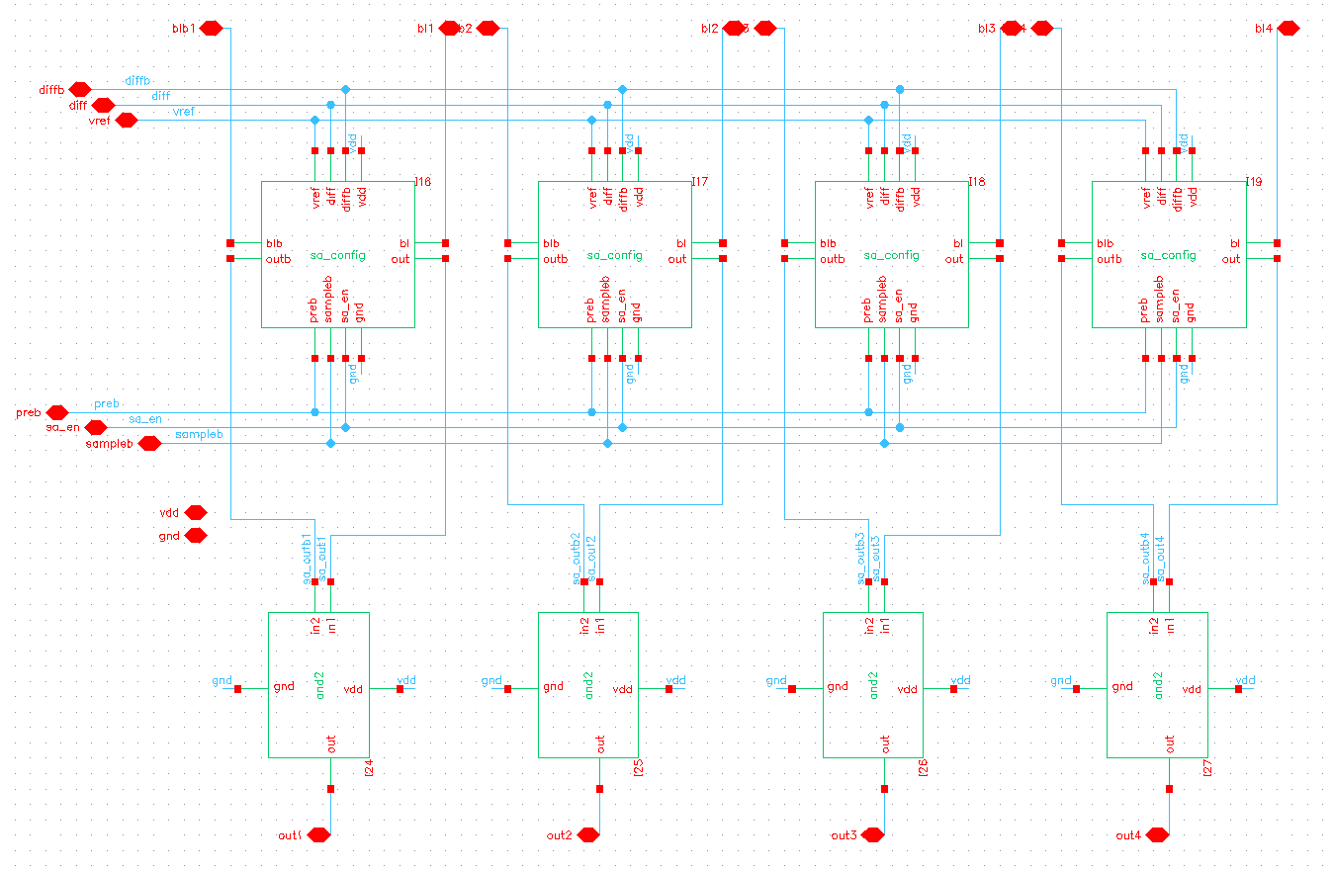
Sense Amplifier Organization
Notes:
BRYCE

Slide 27
Sense Amplifier
Notes:
BRYCE
Jiaxing: The sense amp was the hardest for us to implement because we didn’t know how precharge, sample, and evaluate interacted with each other, and
We took a long time to figure out what the buffer was supposed to do.
(makes sure sense amp can drive output; make sure sense amp outputs a perfect LOW)

Slide 28
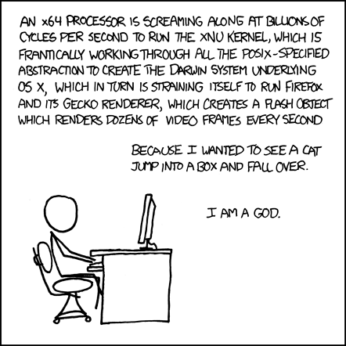
Recap
Configurable memory makes CAM faster and smaller
Minimal impact to SRAM performance
All-in-one SRAM, BCAM, TCAM
Logic Operations as a bonus
(xkcd 676: Abstraction)
Notes:
JIAXING

